Slide 1

Onboarding in OMS Configuration mgmt. with Azure Automation
Stijn Callebaut
@Stijnca
Consultant at Inovativ
PowerShell Hero

Slide 2
Agenda
What is PowerShell DSC
DSC and Azure Automation
Importing configurations
Onboarding nodes
Advanced configuration management

Slide 3
PowerShell DSC

Slide 4
Configuration OMSOnboardingConfig {
Node Server {
WindowsFeature WebServer {
Ensure = 'Present'
Name = 'Web-Server'
}
}
}
Notes:
Configurations allow you to define, via PowerShell syntax, the desired state of your environment in a declarative way.
Opposed to imperative using scripts.
DSC provides a set of Windows Powershell language extensions and resources that can be used to specify how you want your server to be configured.
Running (compiling) a DSC configuration will produce one or more DSC node configurations (MOF documents), which are what DSC nodes apply to comply with desired state.
DSC is the layer that accepts a configuration in the form of a static vendor neutral Management Object Format (MOF) file, a plain-text file in a format developed by the Distributed Management Task Force (DMTF), and implements it. The extensions in Powershell merely provide a Domain Specific Language (DSL) to define a configuration and generate the final MOF which is then executed by DSC. You could potentially write your own administrative interface to DSC. Moreover, since the MOF is based on an open standard, you could implement your own agent that provides the local and native resources to manage an OS. Hence, DSC is an open, cross platform solution to configuration management. The DSC agent on Windows is called the Local Configuration Manager (LCM) - See more at: http://tech.just-eat.com/2015/06/01/deployment-automation-using-powershell-dsc/#sthash.roKzsT7V.dpuf

Slide 5
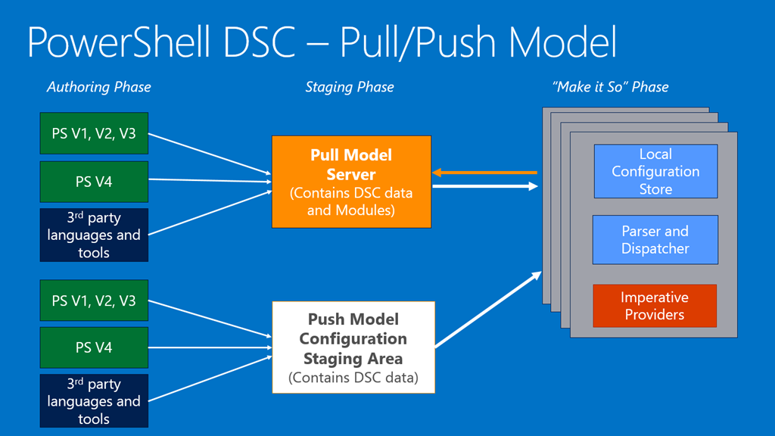

Slide 6
DSC and Azure Automation

Slide 7
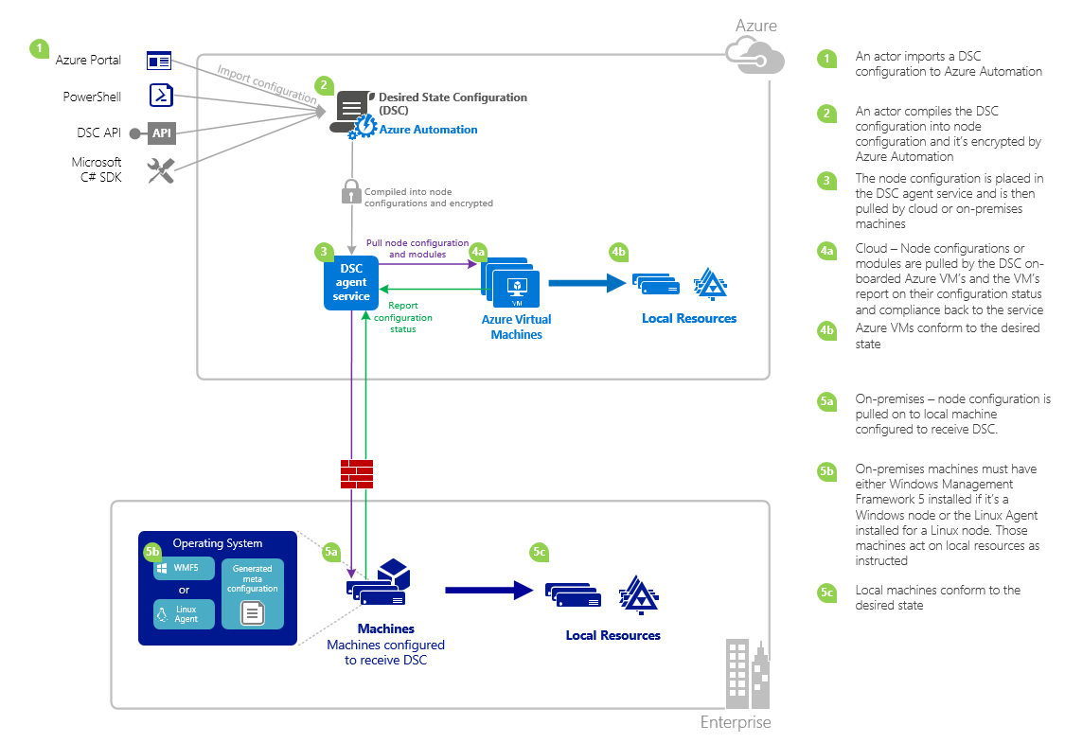
Notes:
Pull Server as a service

Slide 8
Configuration management

Slide 9
Basic configuration
Create a folder
Download the Microsoft Monitoring Agent
Install the agent and onboard OMS
Start the service

Slide 10
DEMO
Notes:
Start from scratch to build our configuration

Slide 11
Onboarding nodes

Slide 12
All onboard
Azure v1 and v2 VMs
Onprem servrs

Slide 13
DEMO
Notes:
Onboard an azure VM using the GUI. (what happens behind the scene? → azure dsc extension is used)
Click the OMS automation account
Click Nodes
Explain the options briefly
Click Add Azure VM
Select vm to onboard
Explain what you read (no Linux, classic via VM extension)
Select the VM member01 to onboard
Click OK
Click Configure registration data
Explain what you see
Leave the defaults
Click OK
And see the VM onboarded
Click the VM
Click Assign node configuration
Select the configuration OMSOnboarding.MMA
Click OK
Explain what happens → DSC extension will be added to the VM with a predefined LCM config
Show the PowerShell code to onboard an Azure VM
Onboard an AWS VM (or Onprem VM), this illustrates that OMS is a total management suite, not just for Azure
Click DSC Nodes
Click add onprem VM
Explain What is mentioned (note, this mechanism is also used in the backed for Azure VMs)
Go to the PowerShell ISE
Explain the script to onboard the AWS server
Needs WMF5
Go to alternative way + explain
Go back up
Explain the easy way
View and edit the file if needed
Copy the file to the AWS server
Enter the session
Set the LCM
In the portal, assign a config
Open the AWS portal and rdp
Update the LCM and watch the config getting applied

Slide 14
Advanced config mgmt

Slide 15
DSC and credentials
Passwords not allowed by default
Use certificates
Clear text passwords
Domain users

Slide 16
DEMO
Notes:
Open Powershell ISE
Explain the configuration CredentialSupport.ps1 (dummy with a PS5 feature PSDSCRunAsCredential)
Open CredentialSupport_import.ps1
Explain the configData
Import the configuration
Compile the configuration
Get the details
If time permits, change the $psallowunencrypted property and compile again

Slide 17
Azure Automation DSC and Linux
Download and install OMI
Install the DSC Linux agent
Import the nx powershell dsc resources
Create your configurations
…
Notes:
OMI = open Management Infrastructure
https://msdn.microsoft.com/en-us/powershell/dsc/lnxgettingstarted
https://github.com/Microsoft/PowerShell-DSC-for-Linux

Slide 18
Additional resources
Getting started with DSC on MVA
Azure automation configuration mgmt.
Ben Gelens Channel 9 AA DSC guide

